Slide 1
Rice plant Disease Classification

Slide 2
Group Information
Submitted to :
Faisal Muhammad Shah
Sajib Kumar Saha Joy
Department of Computer Science and Engineering
Ahsanullah University of Science and Technology
Presented By : 07/09/2022
180104106 Rumana Akter
180104107 Ashif Reza
180104109 Asifur Rahim

Slide 3
Introduction :
Give an easier identification for detecting Rice plant diseases of Bangladesh
Build an effortless system for the identification of Rice plant diseases
Work with Bangladeshi Dataset that contains images of different rice plant diseases

Slide 4
Motivation :
Detection of rice plant disease is crucial for crop protection system.
Traditional visual observation methods are mostly inaccurate.
Laboratory testing requires time and can be expensive.
Insufficient research done on Bangladeshi rice plant diseases.

Slide 5
Literature Review :
Paper 01 : Rice Leaf Disease Detection Using Machine Learning Techniques.
Author : Kawcher Ahmed,Tasmia Rahman,Md irfanul Alam,Sifat Momen(NSU)
Dataset trained using KNN, logistic regression, j48, naive bayes
Three rice plant diseases are detected here
400+ pictures are used here for training
Affected parts were separated using K-means clustering and SVM
For extracting the features of an image, HOG was used
Achieved 96.77% accuracy

Slide 6
Literature Review :
Paper 02 : Rice Blast Disease Detection and Classification Using Machine Learning Algorithm.
Author : S Ramesh and D.Vydeki (VIT Chennai)
Images are classified using ANN
K-Means Clustering is used for Image Segmentation
Only one leaf disease is detected here
Total 300 leaf samples are taken as dataset

Slide 7
Literature Review :
Paper 03 : Application of machine learning in detection of blast disease in South Indian rice crops.
Author: S Ramesh and D.Vydeki (VIT Chennai)
Detected Rice Blast disease using KNN and ANN classification techniques.
K-means Clustering is used for image segmentation
A small dataset of 451 images is used
Detected only one type of disease(Rice Blast)
ANN classifier provides 99% accuracy for normal images and 100% for blast infected images

Slide 8
Literature Review :
Paper 04 : Rice Plant Disease Classification Using Transfer Learning Of Deep Convolutional Neural Network
Author : Vimal K. Shrivastava , Monoj K. Pradhan, Sonajharia Minz , Mahesh P. Thakur
Deep convolutional Neural Network (CNN) as feature extractor
Support Vector Machine (SVM) as a classifier
AlexNet deep CNN pre-trained on large ImageNet dataset was used for feature extraction
Accuracy of 91.37%
Small dataset of 619 images
Based on only 3 types of rice diseases

Slide 9
Literature Review :
Paper 05 : Rice Disease Identification and Classification by Integrating support vector machine with Deep Convolutional Neural Network.
Author :Md.jahid Hasan,Shamim Mahbub,Md.Shahin Alam,Md.Abu Nasim.
A hybrid network integrating Deep CNN with SVM for classification
Features are extracted using D-CNN and SVM classifier is trained with the features.
The proposed model achieved 97.5 % accuracy

Slide 10
Data Acquisition :
Dhan-Shomadhan: A dataset of 5 different harmful diseases of rice leaf called Brown Spot, Leaf Scaled, Rice Blast, Rice Tungro, Sheath Blight.
Dhan-Shomadhans dataset contains 1106 pictures in two different background variations named field background picture and white background picture.
Dhan-Shomadhans dataset can be used for rice leaf diseases classification, diseases detection using Computer Vision and Pattern Recognition for different rice leaf disease.
Website Link:”Dhan-Shomadhan: A Dataset of Rice Leaf Disease Classification for Bangladeshi Local Rice - Mendeley Data”

Slide 11
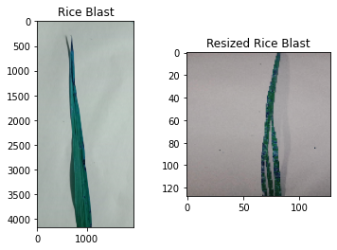
Dataset :
Fig : Before Processing Fig : After Processing

Slide 12
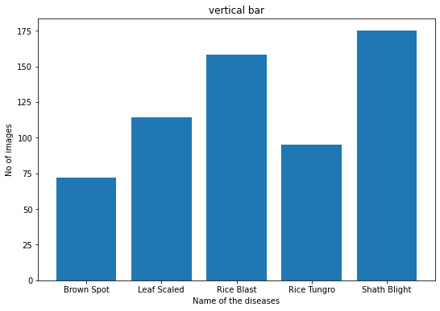
Data Distribution for testing :

Slide 13
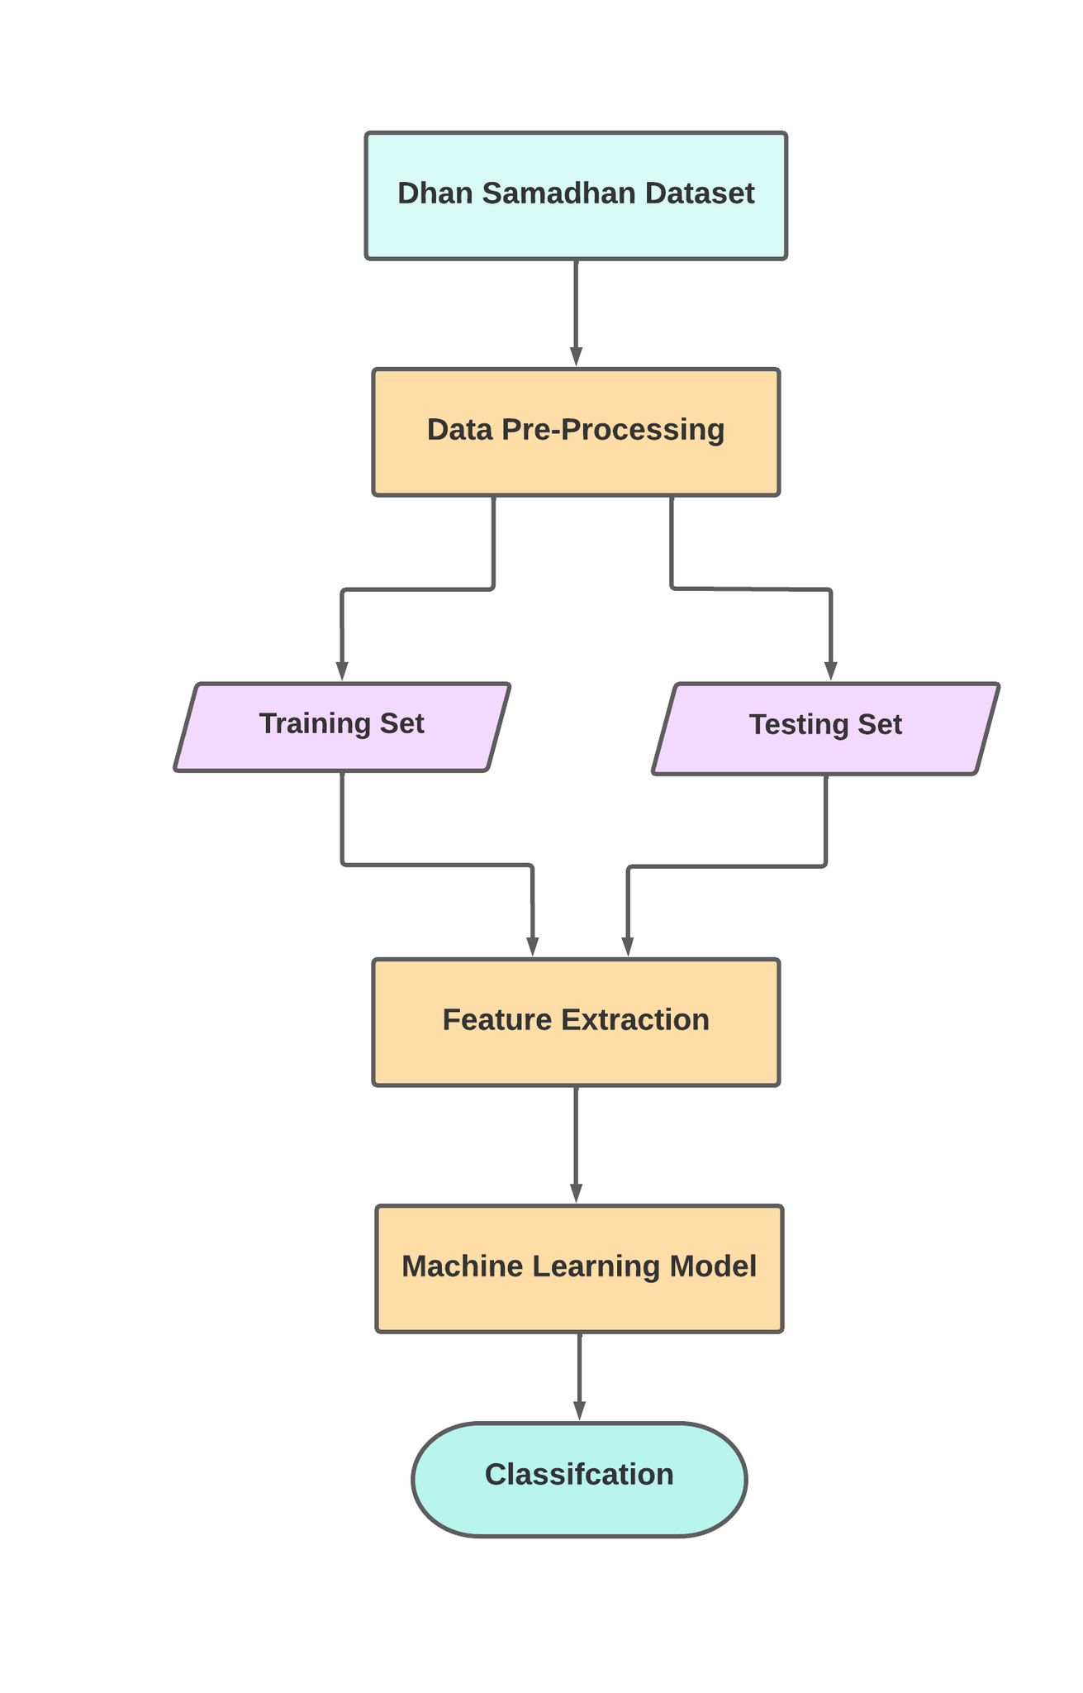
Methodology :

Slide 14




Tools, Devices/Platforms

Slide 15
Result Analysis
Model Name | Test Accuracy
KNN | 39%
SVM | 43%
Random Forest | 46%
Adaboost | 39%
Decision Tree | 34%

Slide 16
Result Analysis for Random Forest :
Model Name | Precision | Recall | F1 Score
Brown Spot | .60 | .17 | .26
Leaf Sclaed | .14 | .07 | .09
Rice Blast | .46 | .82 | .59
Rice Tungro | ..36 | .33 | .35
Shath Blight | .60 | .57 | .58

Slide 17
Result Analysis for SVM
Model Name | Precision | Recall | F1 Score
Brown Spot | .43 | .17 | .24
Leaf Sclaed | 0.00 | 0.00 | 0.00
Rice Blast | .45 | .68 | .54
Rice Tungro | .40 | .33 | .36
Shath Blight | .46 | .66 | .54

Slide 18
Result Analysis for Decision Tree
Model Name | Precision | Recall | F1 Score
Brown Spot | .25 | .06 | .09
Leaf Sclaed | .25 | .14 | .18
Rice Blast | .52 | .28 | .26
Rice Tungro | .36 | .21 | .26
Shath Blight | .32 | .73 | .42

Slide 19
Result Analysis for KNN
Model Name | Precision | Recall | F1 Score
Brown Spot | .25 | .17 | .20
Leaf Sclaed | .28 | .17 | .21
Rice Blast | .47 | .40 | .43
Rice Tungro | .31 | .54 | .39
Shath Blight | .47 | .52 | .49

Slide 20
Result Analysis for Adaboost
Model Name | Precision | Recall | F1 Score
Brown Spot | .18 | .11 | .14
Leaf Sclaed | .17 | .14 | .15
Rice Blast | .44 | .62 | .52
Rice Tungro | .33 | .21 | .26
Shath Blight | .50 | .55 | .52

Slide 21
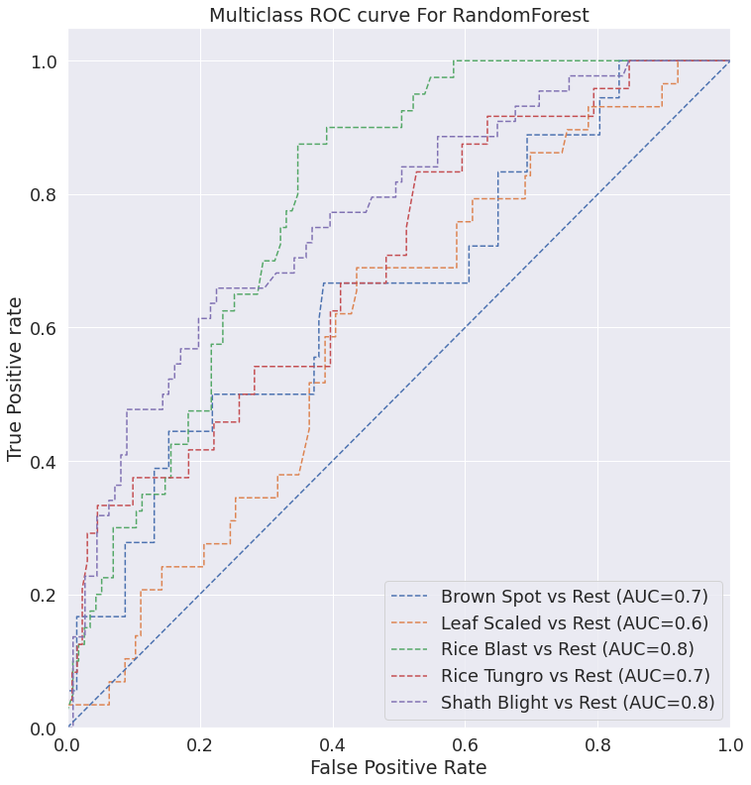
Comparison Analysis :

Slide 22
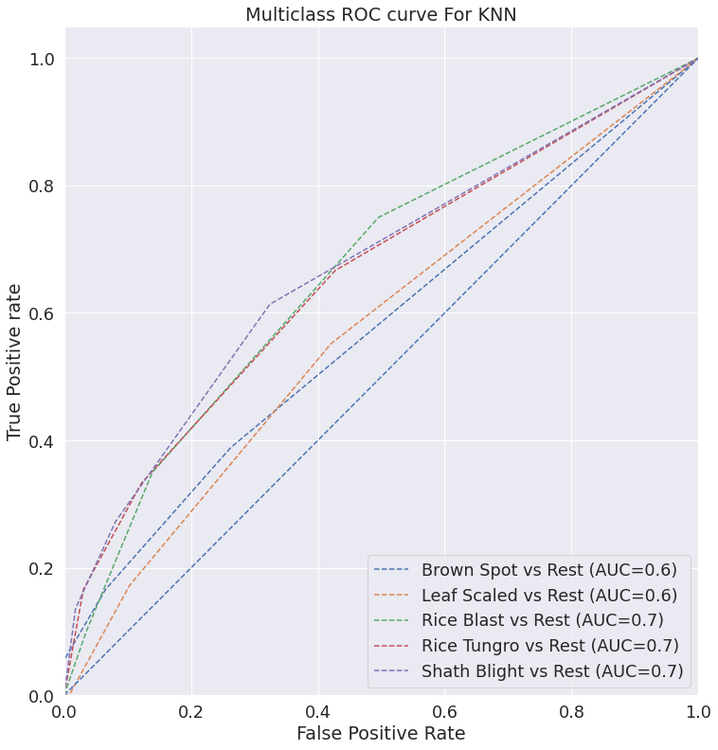
Comparison Analysis :

Slide 23
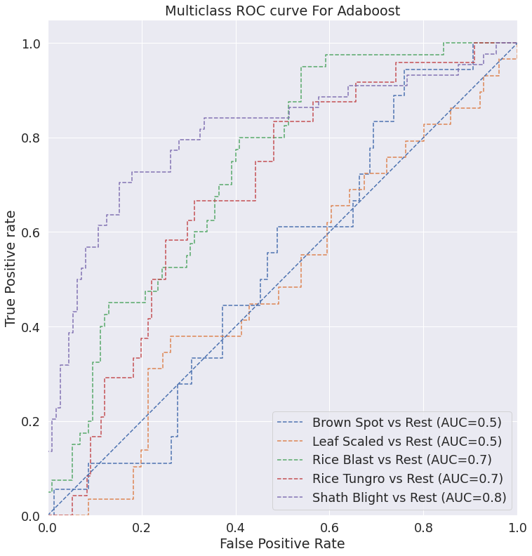
Comparison Analysis :

Slide 24
Future Work :
We will also use the field background images .
For better accuracy we will try to use custom ensemble techniques
Several Machine Learning Algorithms will be used for comparison purposes
We will be taking datasets from other countries and merging them with our local dataset to enhance our testing accuracy and get superior performance

Slide 25
References :
[1] “Rice Disease Identification and Classification by Integrating and Classification by Integrating Support vector Machine with Deep Convolutional Neural Network,2019.”(PDF) Rice Disease Identification and Classification by Integrating Support Vector Machine With Deep Convolutional Neural Network (researchgate.net)””
[2] “Rice Plant Disease Detection and Classification Techniques : A Survey” july-2021.” Rice Plant Disease Detection and Classification Techniques : A Survey – IJERT”
[3] “Rice Leaf Disease Detection Using Machine Learning Techniques.” 2019 “Rice Leaf Disease Detection Using Machine Learning Techniques | IEEE Conference Publication | IEEE Xplore”
[4] “Rice Blast Disease Detection and Classification Using Machine Learning Algorithm.”2021 “Rice Leaf Disease Detection Using Machine Learning Techniques | IEEE Conference Publication | IEEE Xplore”

Slide 26
References :
[5] ”Rice Leaf Disease Recognition using Local Threshold Based Segmentation and Deep CNN.” 2021 (PDF) Rice Leaf Disease Recognition using Local Threshold Based Segmentation and Deep CNN (researchgate.net)
[6] “Application of machine learning in detection of blast disease in South Indian rice crops.” 2019 . (semanticscholar.org)”
[7]”Identification of Various Rice Plant Diseases Using Optimized Convolutional Neural Network.”2021”Identification of Various Rice Plant Diseases Using Optimized Convolutional Neural Network (uob.edu.bh)”
[8]”Rice Plant Disease Classification Using Transfer Learning of Deep Convolutional Neural Network.”Publications_DigiPrint (researchgate.net)”
[9]”Gradient-based learning applied to document recognition.”1998.”Gradient-based learning applied to document recognition | IEEE Journals & Magazine | IEEE Xplore”

Slide 27
References :
[10]”ImageNet Classification with Deep Convolutional Neural Networks”2012,”ImageNet Classification with Deep Convolutional Neural Networks (neurips.cc)”
[11]”Very Deep Convolutional Networks for Large-Scale Image Recognition”2014,”Very Deep Convolutional Networks for Large-Scale Image Recognition (researchgate.net)”
[12]”Rice diseases detection and classification using attention based neural network and bayesian optimization”2021”Rice diseases detection and classification using attention based neural network and bayesian optimization - ScienceDirect”
[13]”Plant Disease Detection and Classification by Deep Learning—A Review”2021,”Plant Disease Detection and Classification by Deep Learning—A Review | IEEE Journals & Magazine | IEEE Xplore”
[14]”Identification and recognition of rice diseases and pests using convolutional neural networks”2020,”Identification and recognition of rice diseases and pests using convolutional neural networks - ScienceDirect”

Slide 28
References :
[15]”Real-Time Object Detection Using YOLO: A Review”2021,”(PDF) Real-Time Object Detection Using YOLO: A Review (researchgate.net)”
[16]”Identification of rice diseases using deep convolutional neural networks”2017,”Identification of rice diseases using deep convolutional neural networks - ScienceDirect”
[17]”Deep Residual Learning for Image Recognition”2016,”CVPR 2016 Open Access Repository (thecvf.com)”
[18]”Deep CNNs for microscopic image classification by exploiting transfer learning and feature concatenation”2018,”(PDF) Deep CNNs for microscopic image classification by exploiting transfer learning and feature concatenation (researchgate.net)”
[19]”Strategy for Rice Disease Management in Bangladesh”2021,”Strategy for Rice Disease Management in Bangladesh | Bangladesh Rice Journal (banglajol.info)”
[20]”Transfer Learning-based Plant Disease Detection and Diagnosis System using Xception”2021,”Transfer Learning-based Plant Disease Detection and Diagnosis System using Xception | IEEE Conference Publication | IEEE Xplore”
”

Slide 29
Thank you

